Slide 1
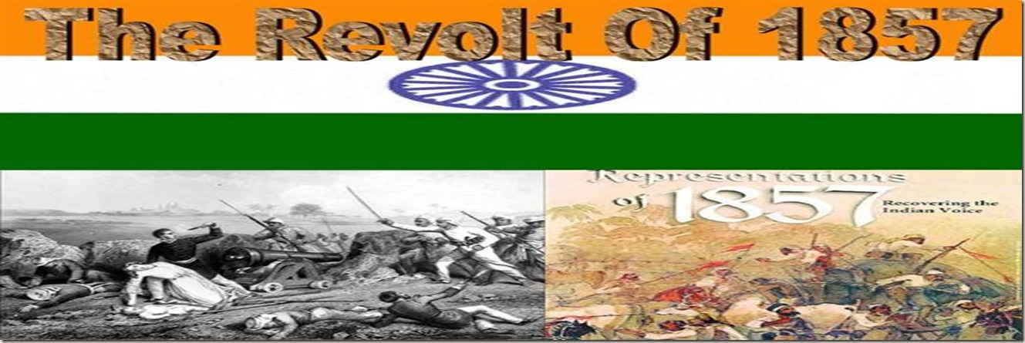
Glimpses of the Past

Slide 2
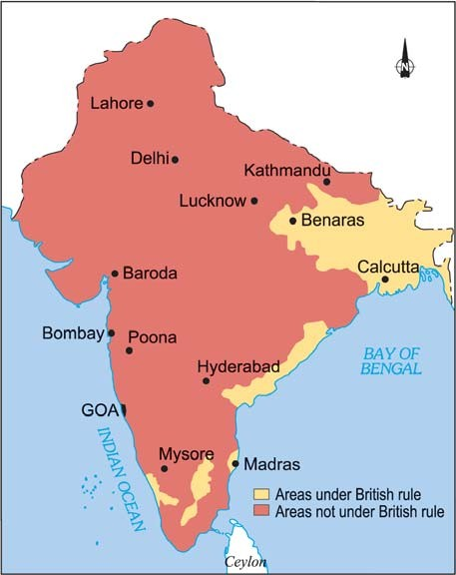
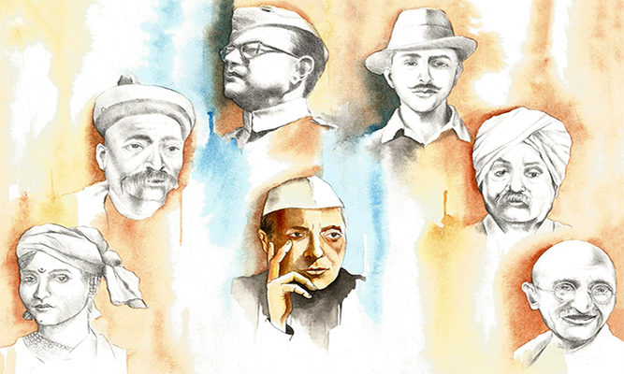
Glimpses of the Past
Module 1
From Our Freedom Movement
S D SAWANT

Slide 3
Before you read
This lesson is an expeditious journey of our country from 1757 to 1857. It is represented through pictures and speech bubbles to clarify our understanding of the conditions that led to the event known as the First War of Independence in 1857.

Slide 4
Synopsis
During 18th century, British east India Company was extending its power worldwide. That time Indian princes were fighting each other. East India Company subdued Indian princes one by one. During the period of 1765 to 1836 India had to witness many incidents. Untouchability, child marriage and other social evils existed in Indian society. The people were superstitious also. The British imposed heavy taxes on farmers so that farmers had to abandon their fields. The east India Company’s law began to cripple Indian industries. Ram Mohan Roy, a learned person from Bengal understood what was wrong with his country.
He was attracted by science and modern knowledge. He went to England and fought for the justice of India. But the British continued to oppress Indians. In 1818 they had passed regulation III, under it, an Indian could be jailed without trial in a court. During 1835-56 Thomas Macaulay suggested a change in Indian Education. They taught Indians their language. By 1856, British had conquered the whole India. Some Indian soldiers in east India Company were ill pleased, discontent was brewing in East India Company’s army too. A soldier named Mangal Pandey attacked the adjutant of his regiment and was executed. In 1857, a violent revolt outbroke. The rebellion spread wider. Many landlords lost their lands, because of the British policies . Many rulers like Begum Hazrat Mahal of Lucknow were bitter. Popular leaders like Maulvi Ahmedulla of Faizabaad, Tantya Tope aroused the people of India to fight against British Raj.

Slide 5
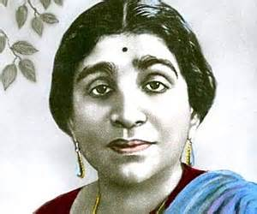
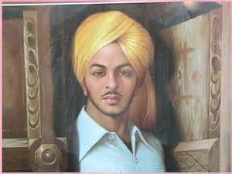
The Martyrs
“Oh my country men! Let your eyes fill with tears, as you recall the sacrifices of India’s martyrs.”

Slide 6
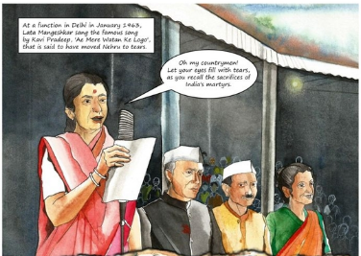
1. The Martyrs
The chapter begins with a tribute paid by Lata Mangeshkar to the martyrs at a function in Delhi.

Slide 7
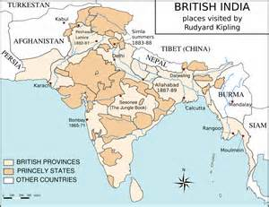
The Company’s Conquests
During 18th century, British east India Company was extending its power in worldwide. That time Indian princes were fighting each other. East India Company subduded Indian princes one by one.

Slide 8
2. The Company’s conquests(1757-1849)
In India of 1757, the East India Company was in a strong position. They had superior weapons. Indian princes were short-sighted in their approach to the events of the time. Indian princes were fighting with each other , often sought the help of the Company to defeat other princes. Thus these rivalries among Indian princes helped the East India Company and it could easily subdue Indian princes one by one. However, the clairvoyant Tipu Sultan of Mysore fought the British till he died fighting.
There were some kings who thanked British for ushering in an era of peace. Others bemoaned that people were gradually becoming slaves of foreigners.

Slide 9
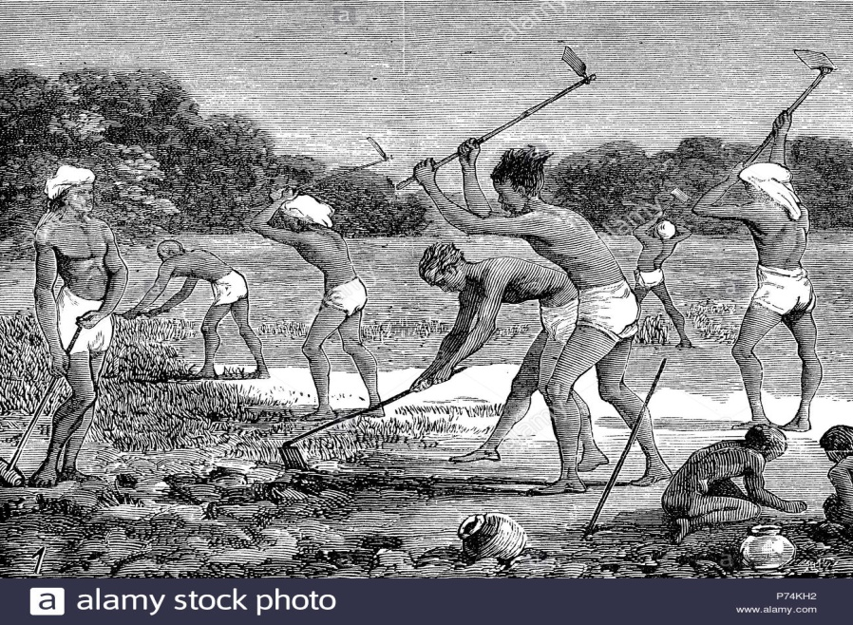
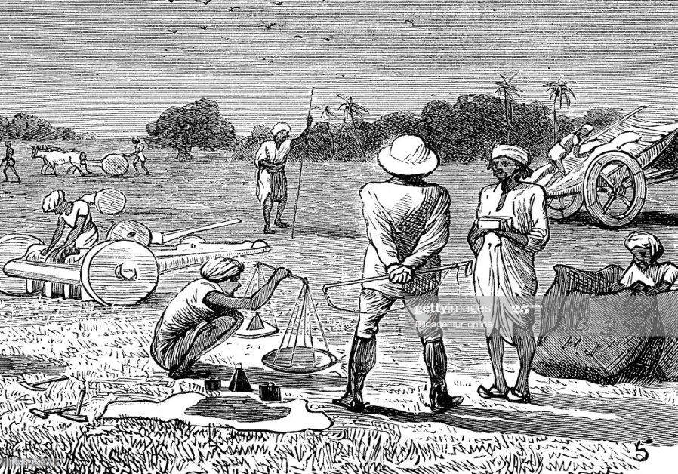
3. British Rule ( 1765-1836)
Religious leaders preached ideas like untouchability and child marriage. Indians lost their self respect. The British scorned them. The British wanted quick profits. Heavy taxes ruined the farmers. The British policies ruined the expert artisans and their business. The imports from England became tax- free. Inevitably, famines followed. Between 1822 and 1836 fifteen lakh Indians died of starvation.

Slide 10
GLOSSARY
1. Glimpse : noun
a momentary or partial view.
2. Martyrs : plural noun
a person who is killed because of their beliefs.
3. Scorned : verb : past tense
feel or express contempt
4. Short – sighted : adjective
lacking imagination or foresight.
5. Subdue : verb
conquer / overpower
6. Thug : noun
a violent person / a bandit / a robber

Slide 11
Exercise for Practice (I)
1. Look at the first picture and identify the singer. Who else do you see in the second picture?

Slide 12
2. What do you understand by the Company’s “superior weapons”?
3. Who is an artisan? Why do you think the artisans suffered?
4. How did the East India Company subdue the Indian princes?

Slide 13
Multiple Choice Questions
Lata Mangeshkar singing a song “oh my countrymen…” at a function in Delhi. The occasion must be
(i). The dawn of India’s Independence where the martyrs and their sacrifices are remembered
(ii). The atrocities of British against the animals
(iii). None of the options
2. The word ‘superior weapons’ means
(i). All their wits, rules , regulations and using of advanced form of arms and ammunition.
(ii). All their intelligence
(iii). All their might and valour

Slide 14
3. The East India Company could easily subdue Indian princes because
(i). There were constant rivalries between the Indian princes
(ii). Indian princes were short sighted.
(iii). Both (i) and (ii)
4. ________ of Mysore fought the British till he died fighting
(i). Tipu Sultan
(ii). Kunwar Singh
(iii). Peshwa Baji Rao

Slide 15
5. Between 1822 and1836 famines ruined the lives of indian farmers and artisans. About ______Indians died of starvation.
(i). Fifteen lakh
(ii). Hundred
(iii). Thousand
6. British were merchants and wanted quick _____
(i). Justice for the Indian farmers
(ii). Relaxation in policies associated with regulation III
(iii). Profits through their iniquitous policies

Slide 16

End of Module 1

